Slide 1
Single-Page Applications
Overview of SPAs
Creating components
Angular routing
Demo app: AngularDev/Demos/02-SinglePageApps/DemoApp
To install: npm install
To run: ng serve

Slide 2
Section 1: Overview of SPAs
What is an SPA?
Demo application

Slide 3

What is an SPA?
According to Wiki:
A single-page application is a web app that fits on a single web page with the goal of providing a more fluent user experience similar to a desktop application.
In an SPA, either all necessary code – HTML, JavaScript, and CSS – is retrieved with a single page load, or the appropriate resources are dynamically loaded and added to the page as necessary, usually in response to user actions. The page does not reload at any point in the process, nor does control transfer to another page.
Interaction with the SPA often involves dynamic communication with the web server behind the scenes.
3

Slide 4
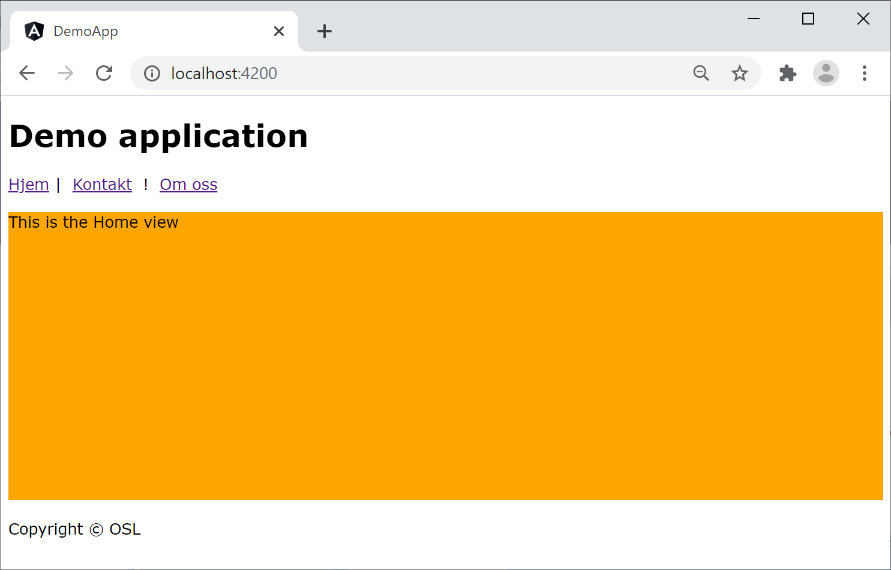
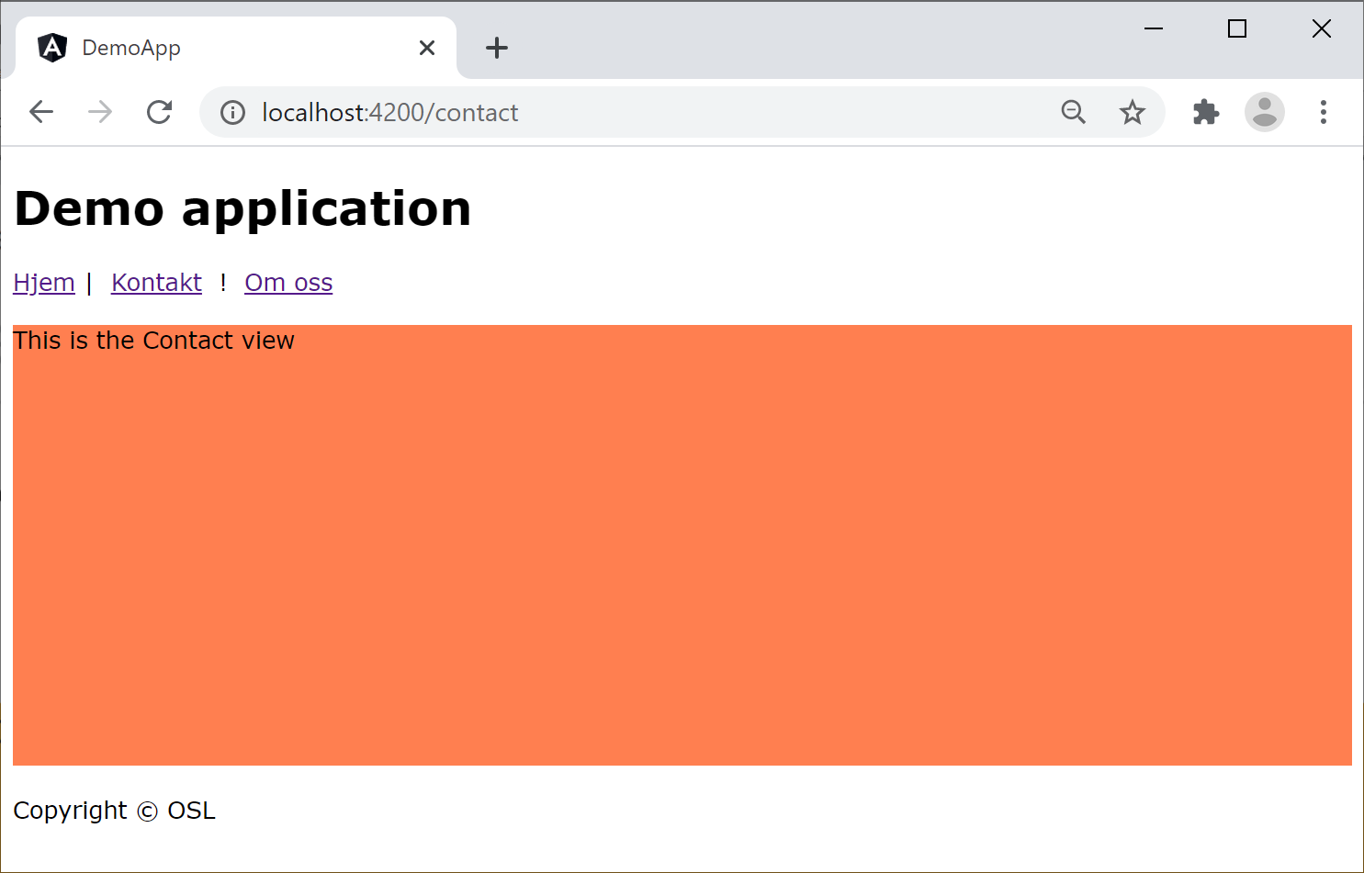
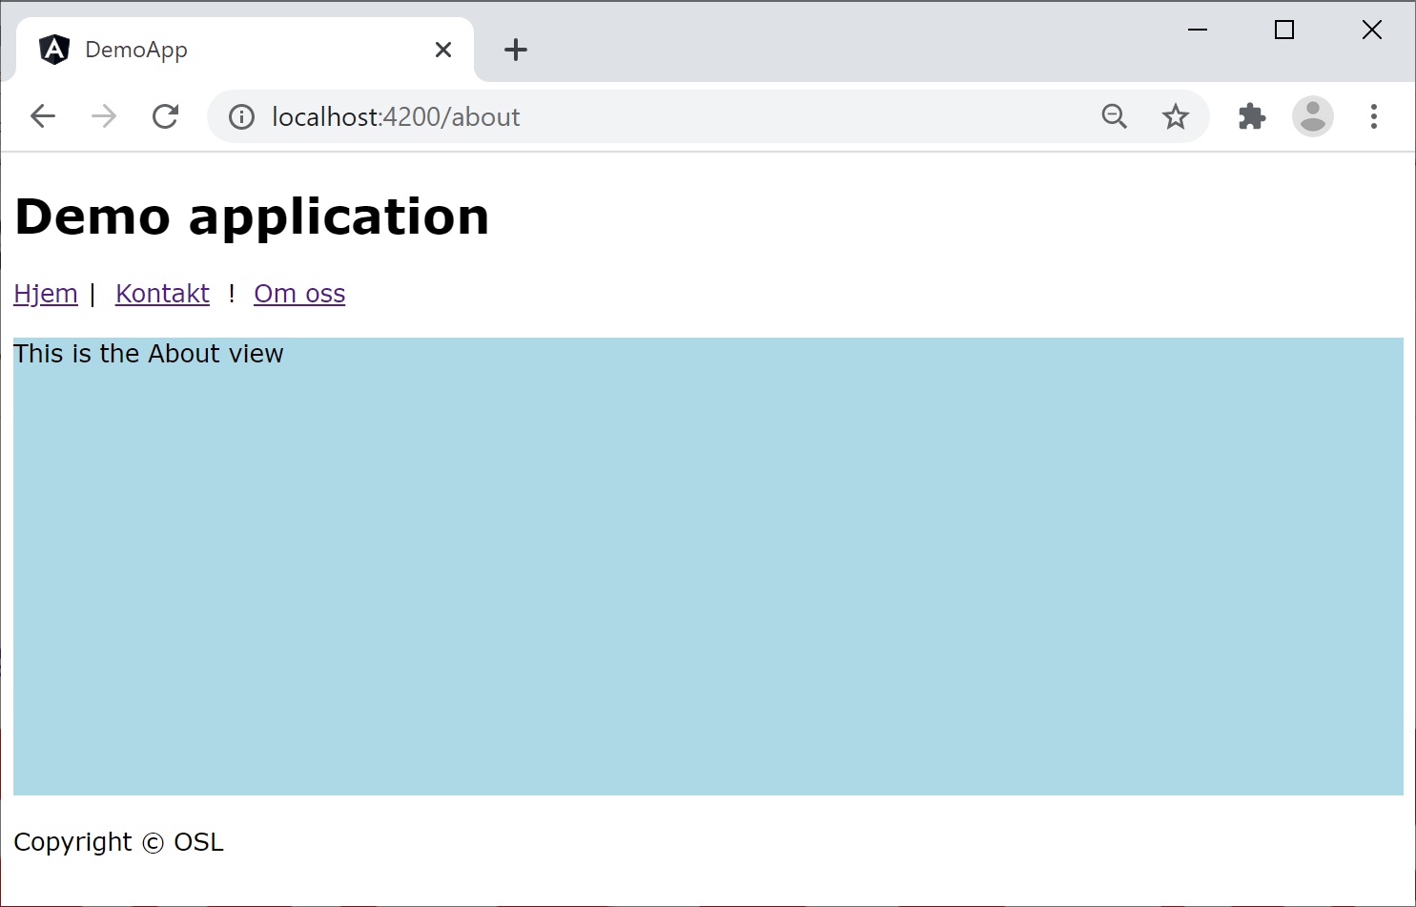
Demo Application (1 of 2)
Angular has good support for SPAs, see this demo:
02-SinglePageApps/DemoApp
/
/contact
/about
4

Slide 5
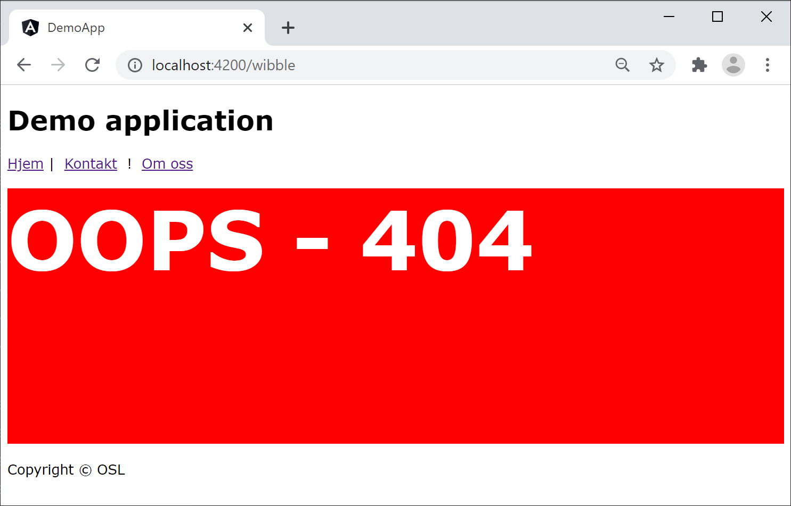
Demo Application (2 of 2)
The application also has a "page not found" component for unrecognised URLs
/wibble
5

Slide 6
Section 2: Creating Components
Overview
Creating artifacts using Angular CLI
How to create a component
Reviewing the component
Summarizing our application's components
Aside: Defining global styles

Slide 7
Overview
An Angular application typically has many components:
A root component (typically named AppComponent)
Plus many additional components
Our demo application has 4 additional components:
HomeComponent
ContactComponent
AboutComponent
PagenotfoundComponent
7

Slide 8
Creating Artifacts using Angular CLI
You can use Angular CLI to create artifacts in your app, such as:
Type of artifact | How to generate using Angular CLI
Component | ng g component my-new-component
Directive | ng g directive my-new-directive
Pipe | ng g pipe my-new-pipe
Service | ng g service my-new-service
Class | ng g class my-new-class
Interface | ng g interface my-new-interface
Module | ng g module my-module
Web worker | ng g web-worker my-web-worker
8

Slide 9
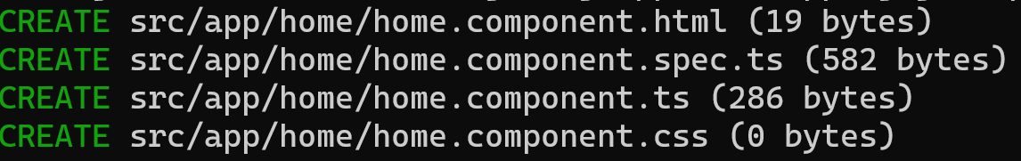
How to Create a Component
This is how we created the home component in our demo application, using Angular CLI
Angular CLI adheres to the Angular style guide:
https://angular.io/guide/styleguide
ng g component home
9

Slide 10
Reviewing the Component (1 of 3)
Angular CLI created a new folder for the component
src/app/home
Angular CLI created 4 files for the component, using a standardized file-naming convention:
home.component.css
home.component.html
home.component.spec.ts
home.component.ts
10

Slide 11
Reviewing the Component (2 of 3)
Here's the code in home.component.ts:
@Component({
selector: 'app-home',
standalone: true,
imports: [CommonModule],
templateUrl: './home.component.html',
styleUrl: './home.component.css'
})
export class HomeComponent {
}
src/app/home/home.component.ts
standalone: true
This component is standalone (it provides all resources it needs, e.g., services, pipes, etc.)
imports: [CommonModule]
CommonModule is a standard Angular module containing essential classes etc. that are needed by all components
11

Slide 12
Reviewing the Component (3 of 3)
Here's our home.component.css:
We've defined simple styles for this component
div {
background-color: orange;
height: 300px;
margin: 20px 0px;
}
src/app/home/home.component.css
12

Slide 13
Summarizing our Application's Components
Here's a summary of the components we generated in our app via Angular CLI:
ng g component home
See src/app/home/
ng g component contact
See src/app/contact/
ng g component about
See src/app/about/
ng g component pagenotfound
See src/app/pagenotfound/
13

Slide 14
Aside: Defining Global Styles
If you want to define global styles that apply across the entire website, define them here:
src/styles.css
Note: The location of global stylesheets is defined in angular.json, via the following property:
projects.XXX.architect.build.options.styles
body {
font-family: Verdana, Geneva, Tahoma, sans-serif;
}
src/styles.css
14

Slide 15
Section 3: Angular Routing
Angular routing dependencies
Defining a routing table
Defining a router outlet
Defining router links
Running the application

Slide 16
Angular Routing Dependencies
If you want your Angular app to support routing, you must have this dependency in package.json:
Note:
Angular CLI adds this dependency automatically
{
"dependencies": {
"@angular/router": "^17.0.0",
…
},
…
}
package.json
16

Slide 17
Defining a Routing Table (1 of 2)
You must define a routing table for your application
Maps relative URLs to components in your app
When the user navigates to one of these URLs:
Angular creates an instance of the relevant component, and renders it in a router outlet (see later)
Relative URL | Map the relative URL to this component…
(none) | HomeComponent
contact | ContactComponent
about | AboutComponent
(anything else) | PagenotfoundComponent
17

Slide 18
Defining a Routing Table (2 of 2)
Here's the routing table for our application:
To see how this file fits into the application structure, see:
src/main.ts
src/app/app.config.ts
import { Routes } from '@angular/router';
import { HomeComponent } from './home/home.component';
import { ContactComponent } from './contact/contact.component';
import { AboutComponent } from './about/about.component';
import { PagenotfoundComponent } from './pagenotfound/pagenotfound.component';
export const routes: Routes = [
{ path: '', component: HomeComponent },
{ path: 'contact', component: ContactComponent },
{ path: 'about', component: AboutComponent },
{ path: '**', component: PagenotfoundComponent }
];
src/app/app-routes.ts
18

Slide 19
Defining a Router Outlet
Somewhere in your UI (typically in AppComponent), define a <router-outlet> where components appear
Angular will display the appropriate component in the router outlet, depending on the current URL
SOME STUFF ALWAYS RENDERED HERE …
<router-outlet></router-outlet>
SOME MORE STUFF ALWAYS RENDERED HERE …
src/app/app.component.html
19

Slide 20
Defining Router Links (1 of 2)
You can define router links in your web pages, to help the user navigate between components
Router links refer to routes in the routing table
<h1>Demo application</h1>
<nav>
<a routerLink="/">Hjem</a>&nbsp;|&nbsp;
<a routerLink="/contact">Kontakt</a> &nbsp;|&nbsp;
<a routerLink="/about">Om oss</a>
</nav>
<router-outlet></router-outlet>
<p>Copyright &copy; OSL</p>
src/app/app.component.html
20

Slide 21
Defining Router Links (2 of 2)
You must also tweak AppComponent as follows:
RouterLink is a directive
It's what implements the routing behaviour when you put routerLink attributes in <a> tags
import { RouterLink, RouterOutlet } from '@angular/router';
…
@Component({
selector: 'app-root',
standalone: true,
imports: [CommonModule, RouterOutlet, RouterLink],
templateUrl: './app.component.html',
styleUrls: ['./app.component.css']
})
export class AppComponent { … }
src/app/app-routes.ts
21

Slide 22
Running the Application
Here's a reminder of how the application looks
/
/contact
/about
22

Slide 23
Summary
Overview of SPAs
Creating components
Angular routing

